Slide 1

ARM Microcontroller Based Programming
Lecture 1
Introduction to ARM Processor
This material is developed by IMTSchool for educational use only
All copyrights are reserved

Slide 2


Advanced RISC Machine
History
1990
ARM was formed in as Advanced RISC Machines Ltd., a joint venture of Apple Computer, Acorn Computer Group, and VLSI Technology.
1991
ARM introduced the ARM6 processor family to meet Apple requirement for its product “Personal Digital Assistant” called Newton.
Unfortunately, the Newton was not a great success and so Robin Saxby, ARM’s CEO, decided to grow the business by pursuing what we now call intellectual property “IP” business model.
The ARM processor was licensed to many semiconductor companies for an upfront license fee and then royalties on production silicon. This effectively incentivized ARM to help its partner get to high volume shipments as quickly as possible.

Slide 3
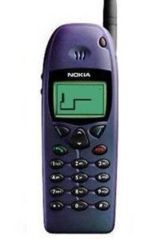
Advanced RISC Machine
History
1993
Nokia approached TI to produce a chipset for an upcoming GSM mobile phone and TI proposed an ARM7 based system to meet Nokia’s performance and power requirements. Unfortunately Nokia rejected the proposal !
ARM came up with a radical idea to create a subset of the ARM instruction set that required just 16 bits per instruction. This improved the code density by about 35% and brought the memory footprint down to a size comparable with 16 bit microcontrollers.
The first ARM-powered GSM phone was the hugely popular Nokia6110 and the ARM7TDMI.

Slide 4
Advanced RISC Machine
History
1997
ARM had grown to become a £27m business with a net income of £3m !
ARM then decided to build software-based systems on a single chip, the so-called system-on-chip, or SoC.
2001
ARM9 was announced. It was fully synthesizable with a 5 stage pipeline and a proper MMU, as well as hardware support for Java acceleration and some DSP extension.
2002
ARM11 families had extended the capability of the ARM architecture in the direction of higher performance with the introduction of multi-processing, SIMD multimedia instructions, DSP capability, Java acceleration etc

Slide 5

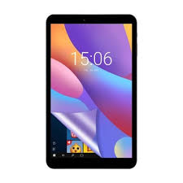
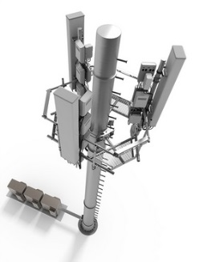

Advanced RISC Machine
History
2005
The ARM Cortex … !
Cortex - A
Cortex - R
Cortex - M
Application Processors for full OS and Open Application Platforms
Embedded Processors for real time signal processing and control applications
Microcontroller Oriented Processors

Slide 6
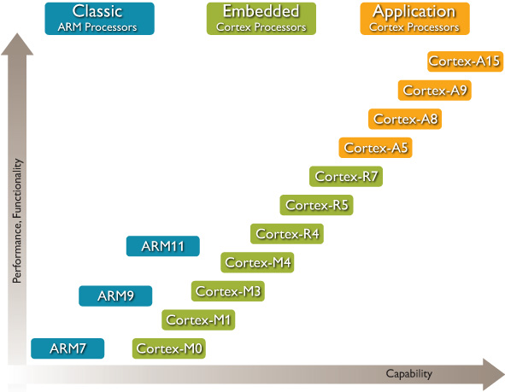
ARM Processor Roadmap

Slide 7

ARM Silicon Partners

Slide 8
ARM Major Characteristics
High Performance
Low Cost
Low Power
Enhanced determinism
Ease of use
Wide choices

Slide 9
General Processor Architecture
Register File
Address Bus
CU
ID
PC: Program Counter
Data Bus
IR: Instruction Register
Operand 1
Operand 2
ACC: Accumulator
PSW: Processor Status Word
Control Bus
Selection Signal
GPR: General Purpose Registers
ALU
CU : Control Unit
ID : Instruction Decoder
ALU: Arithmetic Logic Unit

Slide 10
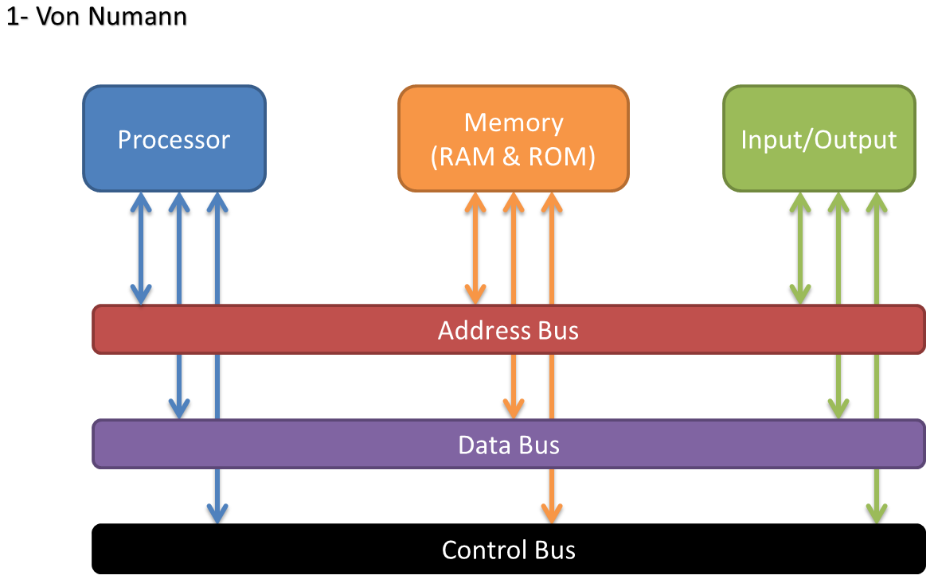
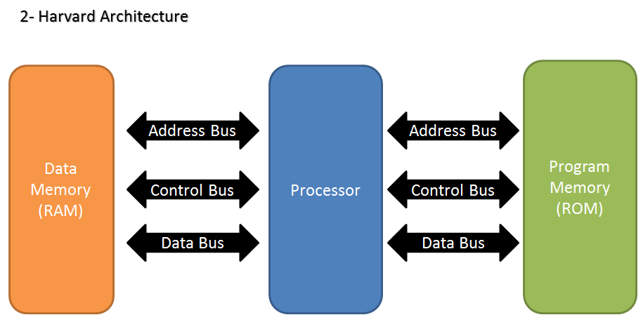
Von Numann Vs Harvard Architecture
Simple in Design
The code is executed serially
Complex in design
The code is executed in parallel

Slide 11
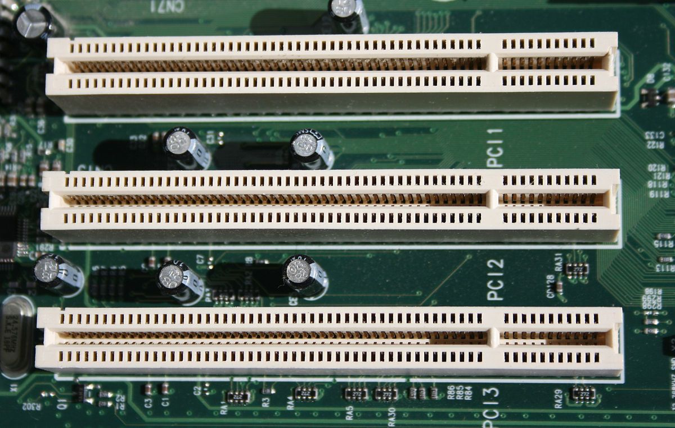
Bus Architecture
Note: Bus Definition
Bus is not just a group of wires, a bus is a communication system that transfers data between components inside the processor, or between processor and peripherals. This expression covers all related hardware components (wire, optical fiber, etc.) and software, including communication protocols.
Example:
PCI Bus
Peripheral Component Interconnect

Slide 12
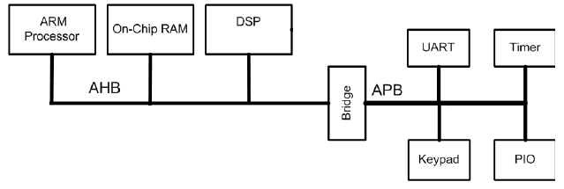
ARM Bus Architecture
AMBA Bus
Advanced Microcontroller Bus Architecture
Open standard, on-chip interconnect specification for the connection and management of functional blocks in system-on-a-chip (SoC) designs. It was introduced by ARM in 1996 and currently it includes some protocols that considered as de facto standard for embedded processors because they are well documented and can be used without royalties.

Slide 13
AHB Vs APB
AHB
stands for Advanced High Performance Bus
APB
stands for Advanced Peripheral Bus
High Performance
Full Duplex
Support Pipelining
MultiMaster operation
Complex in design
Low Power
No Pipelining
Simple in design
Used for connecting peripherals

Slide 14
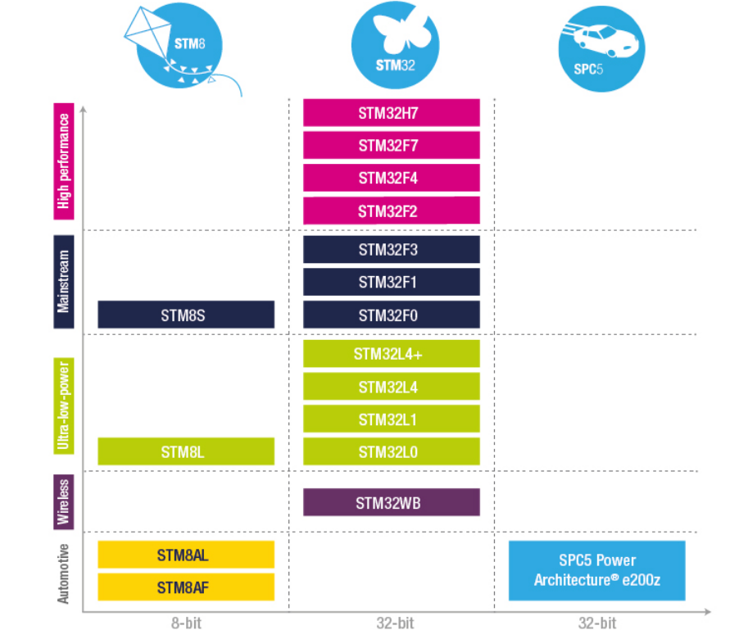
ST Product lines

Slide 15
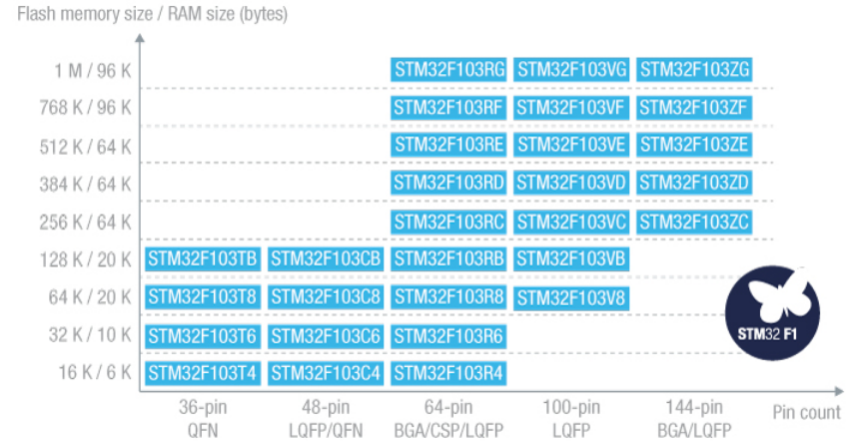
STM32F103 Family

Slide 16
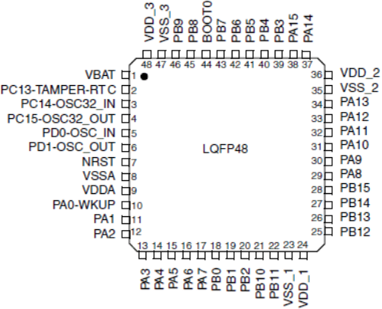
STM32F103C8 Specifications
Core | ARM Cortex-M3
Max Operating Frequency | 72 MHz
Flash Memory Size | 64 KB
RAM Size | 20 KB
Timers | 4 x 16 Bit Timers 2 x WDT 24-Bit Down Counter RTC
ADC Converter | 10 x 12 Bit Channels
GPIO | 32 High Current
I2C Bus | 2 Channels
SPI Bus | 2 Channels
USART Bus | 3 Channels
CAN Bus | 1 Channel
Operating Voltage | 2 to 3.6 Voltage
Operating Temperature | - 40 to 105 Degree C

Slide 17
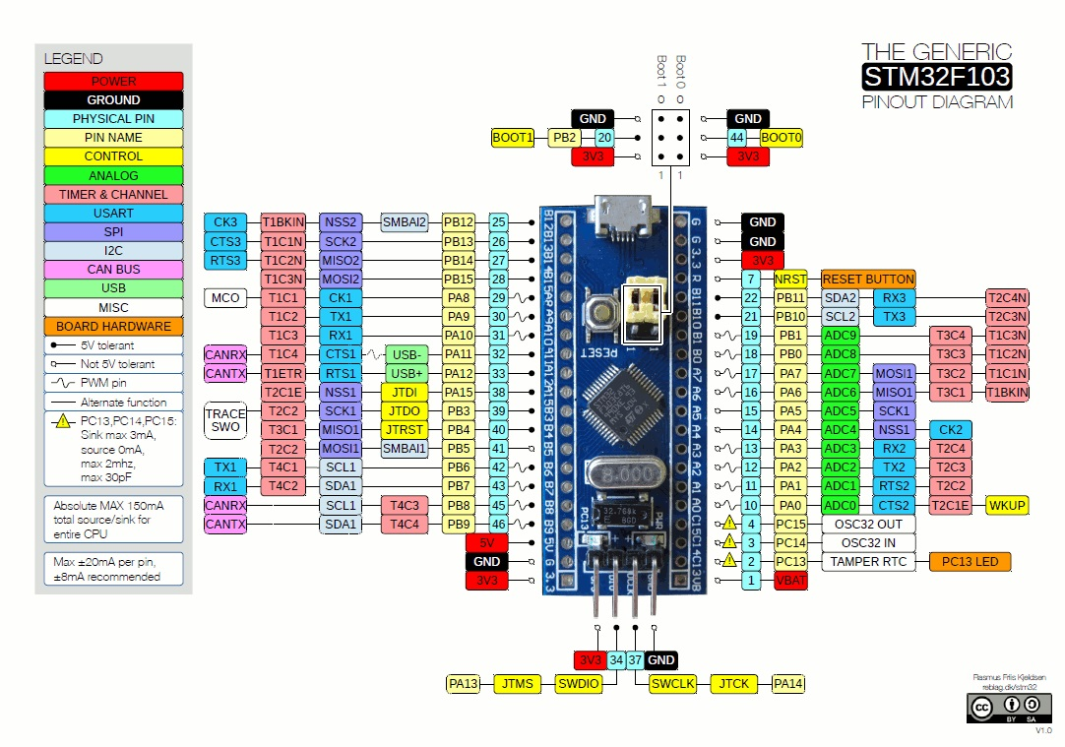
Development Kit

Slide 18
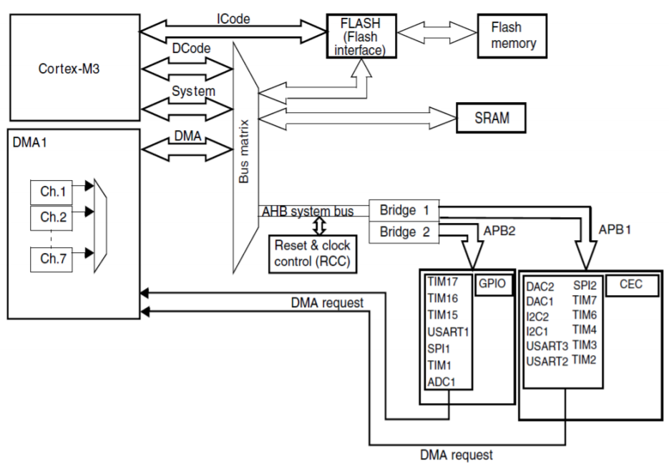
Processor Architecture

Slide 19
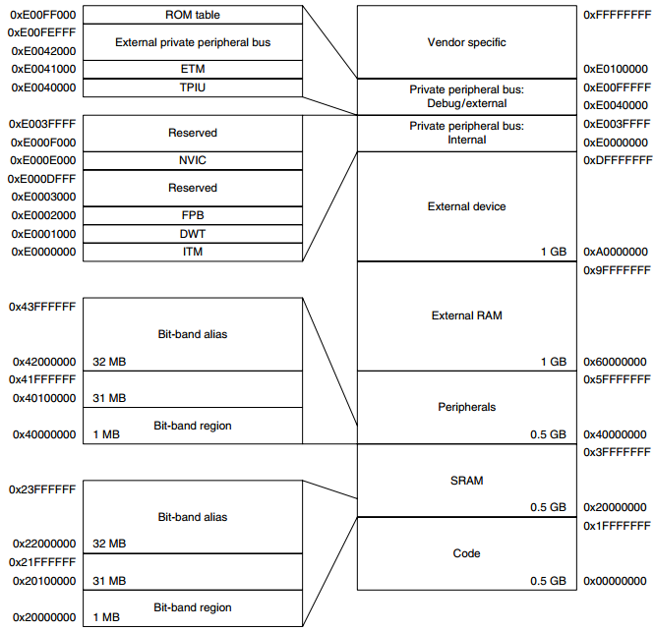
Memory Map

Slide 20
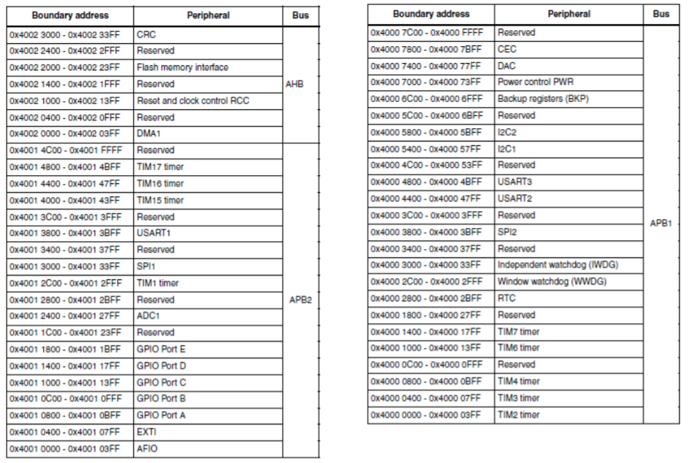
Bus Connections

Slide 21


www.imtschool.com
ww.facebook.com/imaketechnologyschool/
This material is developed by IMTSchool for educational use only
All copyrights are reserved

